Slide 1

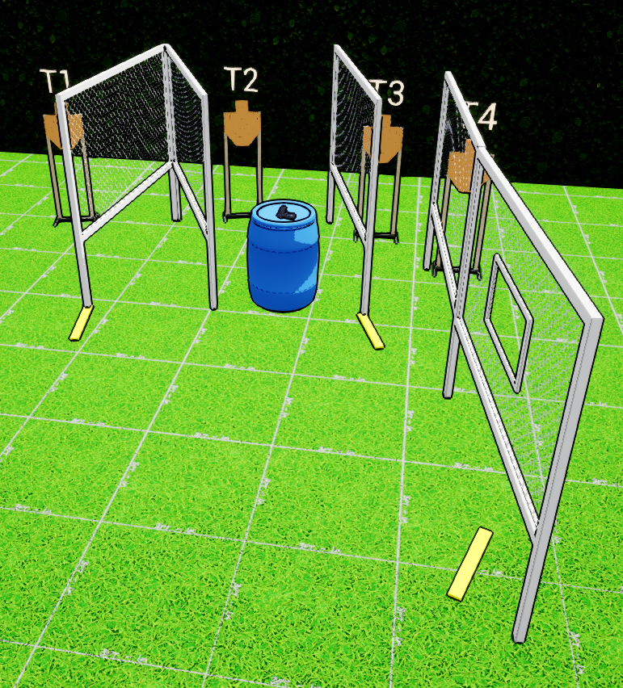
 | Interlake Sporting Association Action Bay, B Stage: Ignore The Man Behind The Curtain Course Designer: Marcel Englmaier & Stanley Lewis
START POSITION: Standing with hands touching marks, gun loaded and holstered, wrists below belt. PCC Loaded, safety on. Stock touching belt with muzzle pointing at berm and touching wall under either X. |  | STRINGS: 1 SCORING: Unlimited SCORED HITS: 9 START-STOP: Audible - Last shot
STAGE PROCEDURE: At the start signal, engage all targets from available cover positions. Reload required between first and last shot.

